Slide 1
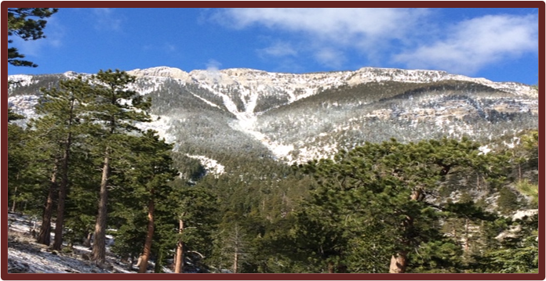
DEER CREEK PARK
first time offered to the public in over 80 years

Slide 2
Deer creek park
Las Vegas Age, Newspaper Ad (Circa 1929)
Property overview
These properties are an assembly of lots/owners being offered for sale as one property group. The Deer Creek Lodge and properties located in the historic Deer Creek Park Subdivision embrace the rich history of Las Vegas dating back to the late 1920’s and 30’s. Fueled by the Union Pacific Railroad, the original Deer Creek Park was the result of the nationwide boom of the roaring 20’s and the boomtown of Las Vegas,. Described in the Newspaper Article (left) that appeared in the Las Vegas Age in 1929 “it is an ideal location for a summer playground”. The original developers received approval for the Deer Creek Park subdivision by the Clark County Commission in 1932. The future development opportunities range from maintaining the existing properties, restoration of older cabins to a wide variety of developments including a private recreation resort to an exclusive residential developments.

Slide 3
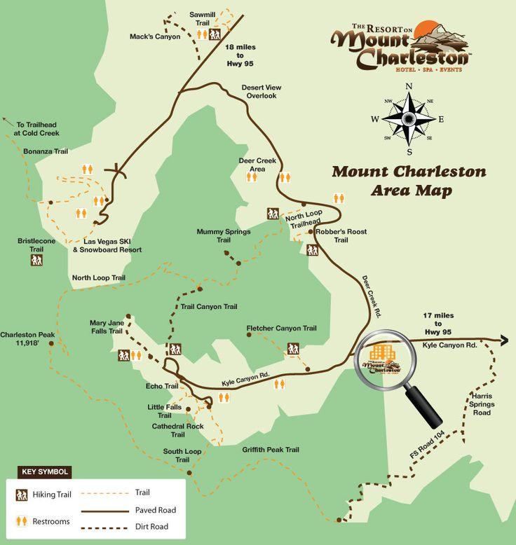
LOCATION AND VACINITY MAP
Deer Creek Park

Slide 4
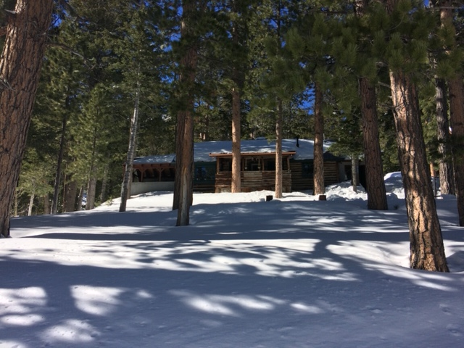
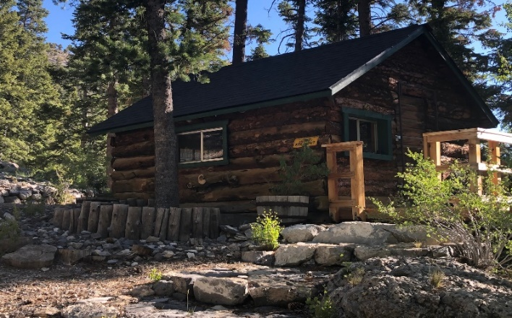
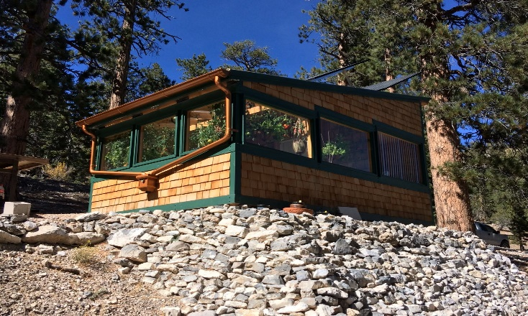
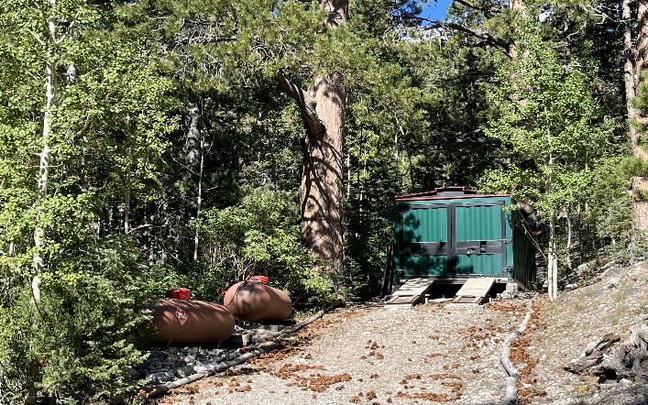
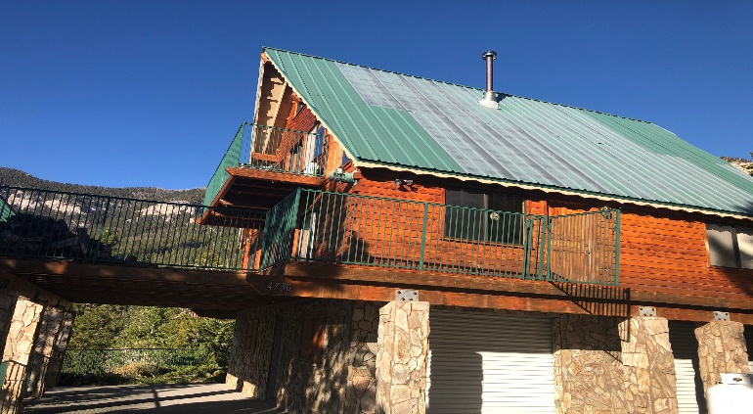
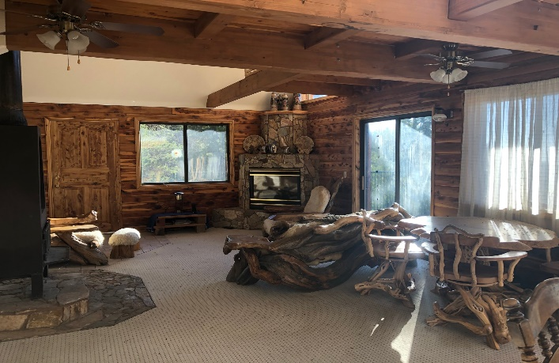
Deer Creek Park existing Lodges and structures
Lodges and Structures
The Deer Creek Lodge was constructed in 1929 by the original Builder/Developer. A worker's cabin below the Lodge was constructed that has been renovated and currently the guest cabin. The construction crew were master log cabin builders from Colorado. Construction material was burnt standing (naturally kiln dried) lodge pole pine half logs. All building lumber was milled on site at the Old Sawmill. The customized container and
shop was modified to accommodate the Snowcat and houses the power system equipment and generator.
The upper Lodge/Cabin was constructed in 1986. The lower level two car garage is constructed of solid grout cinder block and the upper levels are milled cedar logs. Interior is finished with custom doors and cabinets. Large decks surround the cabin. A solar powered well supplies the water.
The old Sawmill shut down when construction was halted after the Great Depression. With the abundance of fresh mountain spring water, this Old Sawmill was repurposed to a distillery during prohibition.
The Deer Creek park Lodge
LODGE GUEST CABIN
GREENHOUSE
Garage/Shop
upper LODGE
upper LODGE

Slide 5
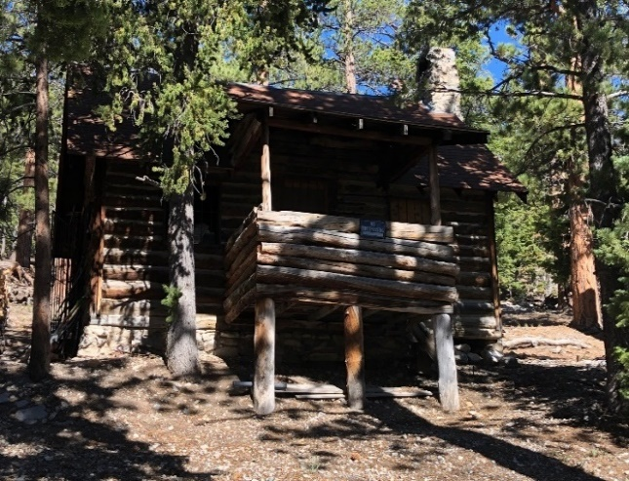
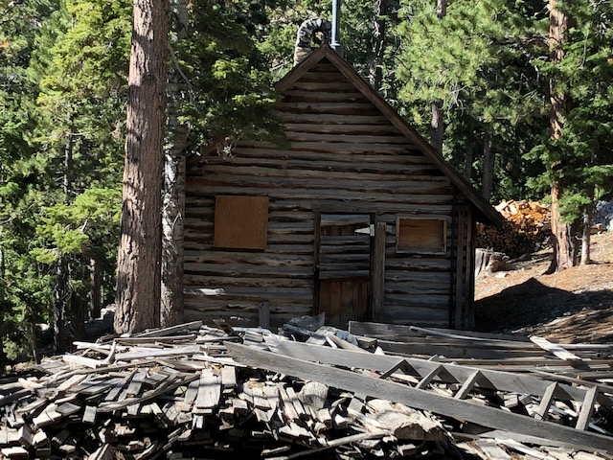
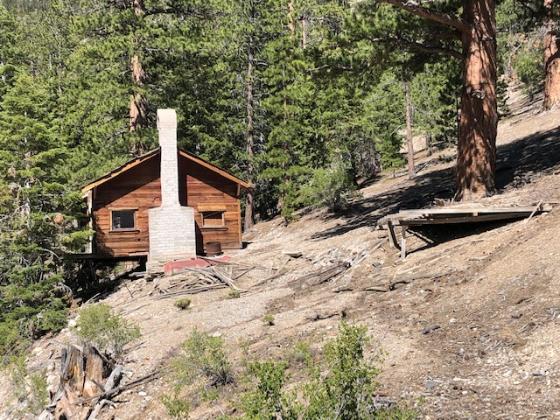
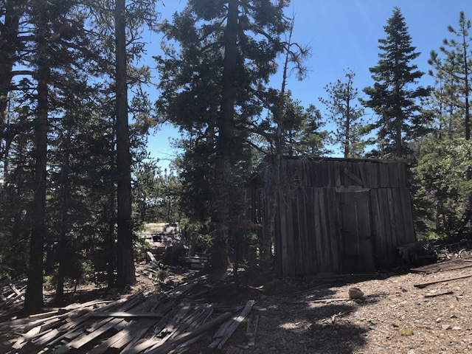
Deer Creek Park, historic structures
Original Model Cabin
Original Model cabin
Existing Cabin
Old Sawmill/ Distillery

Slide 6
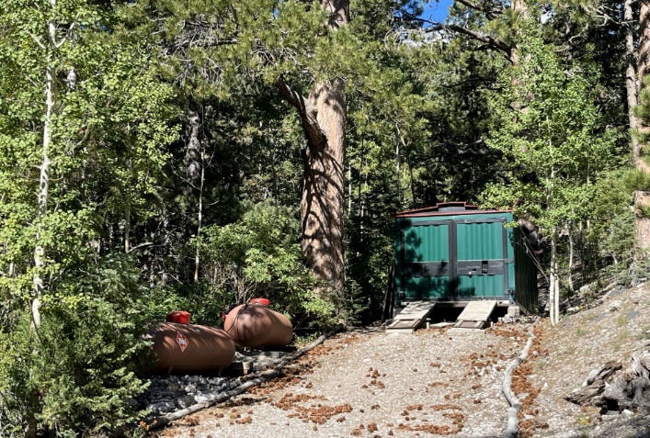
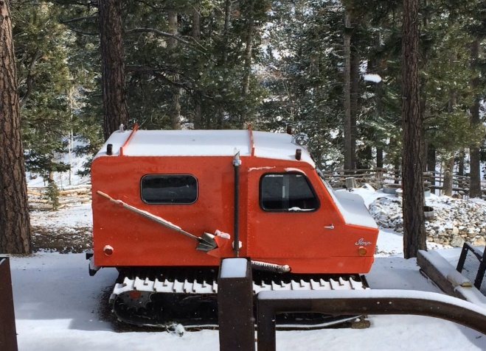
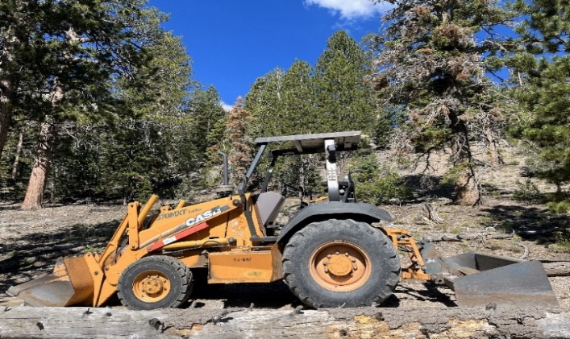
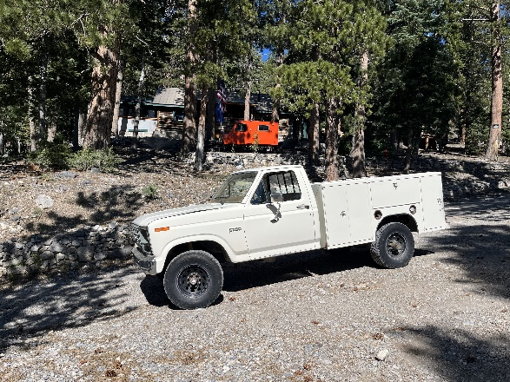
Snow Access, Maintenance Vehicles and Equipment Included in Sale
customized (10x25) heated container
1975 Thiokol Imp 6 Passenger Snowcat
Case Turbo Diesel Loader/ Grader
1985 Ford F 250 4WD Service Truck
All tools and equipment are being sold with the property. The Shop houses the power system for the property including a generator, 24 Volt Solar System and Hydro Electric Plant. It provides 120 Volt AC power to all structures and Two 500-gallon propane tanks supply the fuel for the generator and household appliances.

Slide 7
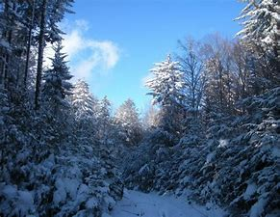
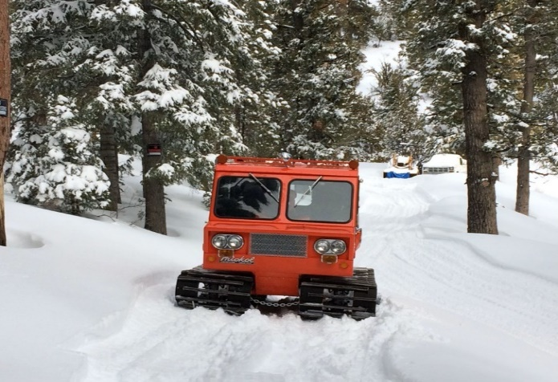
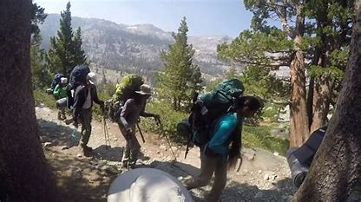
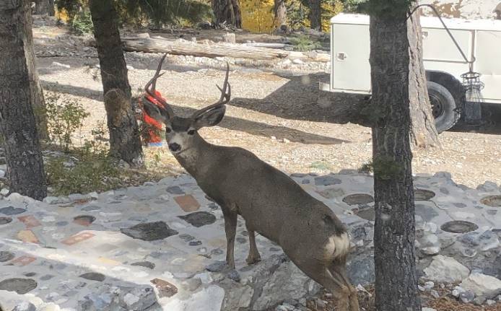
Deer Creek Park Recreation AND AMMENITIES
WILDERNESS SNOWPLAY, SKING AND SNOWBOARDING
SNOWCAT ACCESS
MOUNTAINEERING HIKING AND CAMPING
LOCAL VISITORS

Slide 8
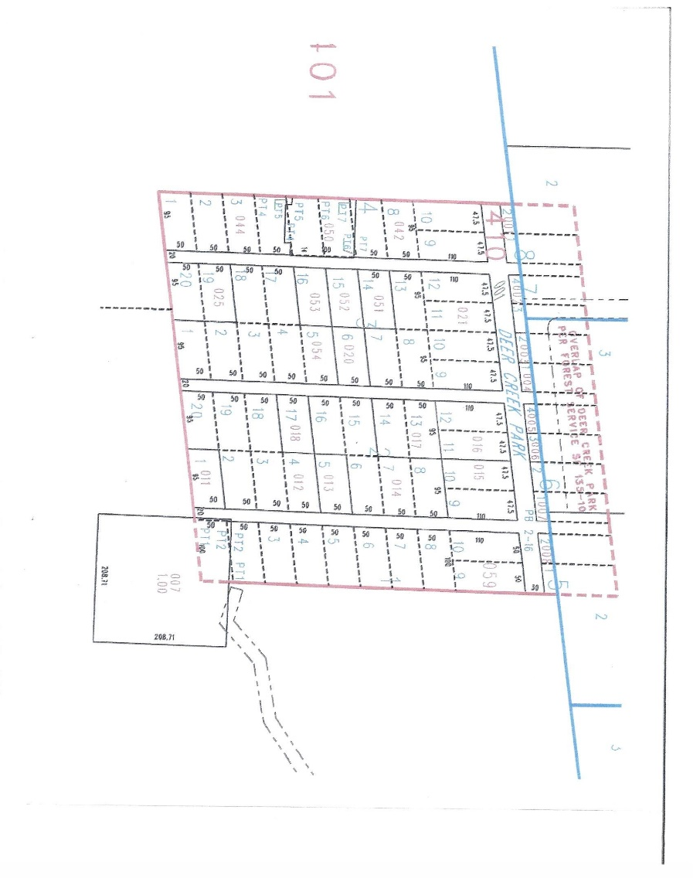
Offered Property Existing Parcel Map
Parcel Descriptions
Parcel H-1: 2.3 (+/-) Acres
Parcel H-2: 2.3 (+/-) Acres
Parcel H-3&4: Deer Creek Park Lots 1&2 Block 8
Parcel D-1: 1 (+/-) Acres includes Lot 1 Block 1 DCP
All other parcels in the Deer Creek Park Subdivision except lots labeled Not a Part total
Approx. 10 (+/-) Acres
Each Lot is approximately
50 ft. by 100 ft for a total number of 67 lots
Approximate Total
Acreage (+/-) 15.5 Acres
Structures
Deer Creek Lodge: renovated Original Historic Lodge circa 1932. Approx. 1200 Sq. ft
Guest cabin: Renovated historic Guest cabins approx. 300 Sq. Ft.
Upper Lodge: 3 story lodge built in 1996. Approximately 2600 Sq. ft.
Renovation cabins: vacant cabins suitable for renovation
Parcel H-2
Existing Well
Old sawmill distillery
Parcel H-1
Upper Lodge
Existing Water Line
Parcel H-3 & 4
Renovation
Cabins
Deer Creek Lodge
Parcel d-1
Guest
Cabin
Not A Part
Parcel D-2
South Fork Deer Creek

Slide 9
1932 Recorded subdivision map

Slide 10
Deer creek park
These properties are being offered for sale at a sales price of
$5,900,000.
in an as is, where is and with all faults condition
Partial owners are Nevada Real Estate Licensee’s
Exclusively Offered By: David Hensley
Nevada Real Estate License # 004261
Clark County Management Corporation
7490 West Sahara Ave.
Las Vegas, Nevada 89117
Phone: 702-325-4298
Website: www.VegasRanches.com
Email: sales@vegasranches.com

