Slide 1
THE SANDSTONE RANCH MULE Springs, Nevada
Offered By :
Clark County Management Corporation
7490 West Sahara Ave.
Las Vegas, Nevada 89117
And
The Las Vegas Land & Water Company, LLC
Dave Hensley, Exclusive Agent
( NRED Lic. # 0014261 )
702-325-4298
www.vegasranches.com
Email: sales@vegasranches.com

Slide 2
Sandstone Ranch History
Prior to western settlers arriving in the Las Vegas Valley, the archeological records show the Southern Piute's frequented nearly all the natural springs
in and around the Spring Mountains for hunting and gathering.
Beginning in the late 1820’s, western settlers were transiting the Old Spanish Trail through the Las Vegas area. Some of the settler’s started ranching near the natural springs in the Spring Mountains and Red Rock Canyon areas. The “proving up on the water” was one of the main requirements for the issuance of a US Patent. This is evidenced by the current Water Certificate for the development of Mule Springs on November 1, 1909. The Certificate approves the reservoirs, troughs and pipe-lines for the purpose of domestic and stock watering. This 1909 document was filed by the Wilson Brothers at the Wilson’s Ranch via Arden, Clark County, Nevada. Although deteriorated after over 100 years of weather, portions of the troughs and pipe-line ( to State Route 160 ) remain and are noted on the BLM, Land Status Map .
On December 27th 1929, the Kaiser Family was issued a US Patent for the 80 acres surrounding Mule Springs by the Nevada, Secretary of State.

Slide 3
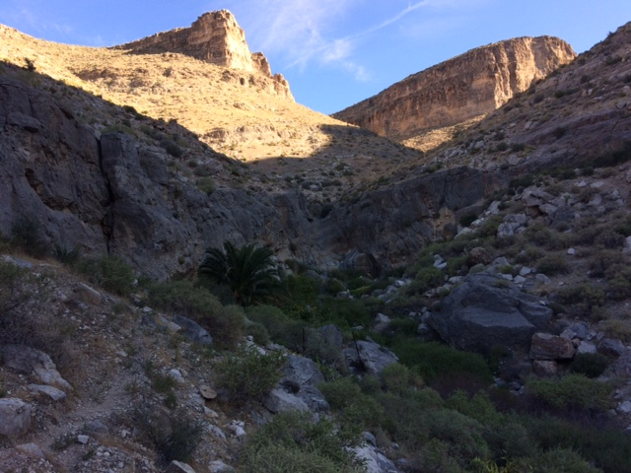
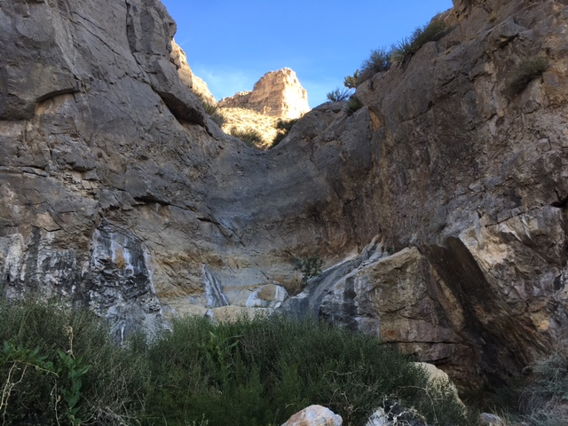
Sandstone Ranch Water Overview
SPRING #1
SPRING #2
In the arid Nevada desert, the spring water that flows year-round is the critical ingredient to the rich history of cattle ranching and the development of Southern Nevada in and around the Spring Mountains.
As described in the 1909 State Water Certificate, “the amount of water is 0.025 cubic feet per second from each of the two spring water sources, for the purpose of domestic and stock watering of 500 to 900 head of cattle. The “Description of works” includes dams, small reservoirs, wooden troughs and piping where the
water is impounded from the two sources.

Slide 4
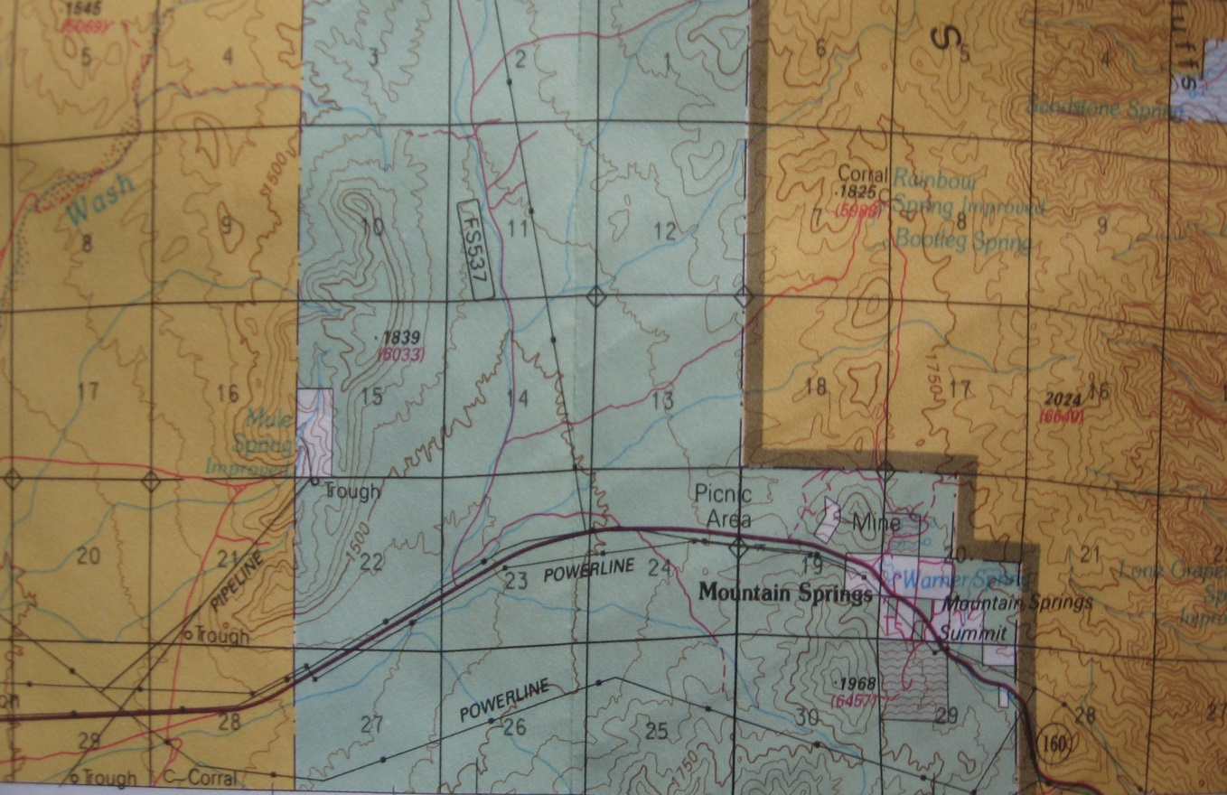
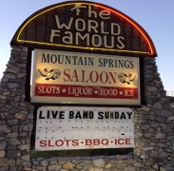
Property Location and Description
Sandstone Ranch
80 (+/-) Acres
BLM LAND
US FOREST SERVICE
Historic Pipelines & Troughs
Power Line
SR 160
To Las Vegas
To Pahrump
Property Location and Access
The property is located approximately 15 miles west of Las Vegas. Access is by State Route 160 (Blue Diamond Road ) toward the Pahrump Valley and 4.5 miles past the small mountain community of Mountain Springs Summit. From the paved divided highway, access is by a 1.5 mile unimproved road. The elevation rises from approximately 4900 Ft. ASL at the base, to
Approximately 5400 Ft. ASL at the summit.
Property Description and Entitlements:
This 80 Acre Parcel is surrounded on all four sides by US Government Land.
The North, East and Western Boundaries are US Forest Service (Toiyabe National Forest) and
the Southern boundary is US BLM Land. Based on the US Patent, the property has all mineral rights excluding Oil and Gas which was reserved by the State of Nevada
Power is available approximately 1.5 miles at the entry road adjacent to the paved highway.
According to the Clark County Development Code, the property is Master Planned/Zoned
(RU ) Residential Urban that entitles the property to One Residential Unit Per Two (2) Acres.

Slide 5
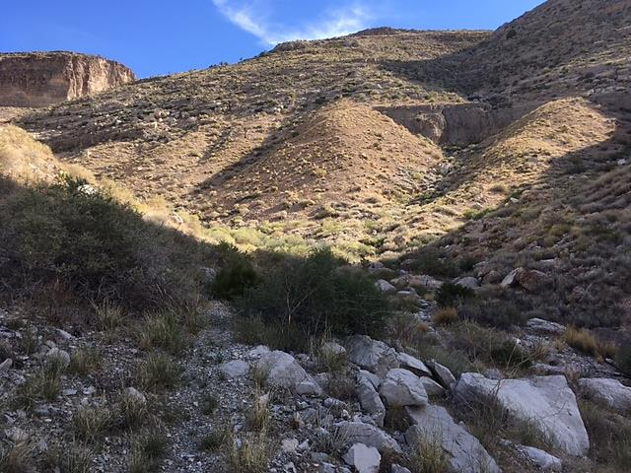
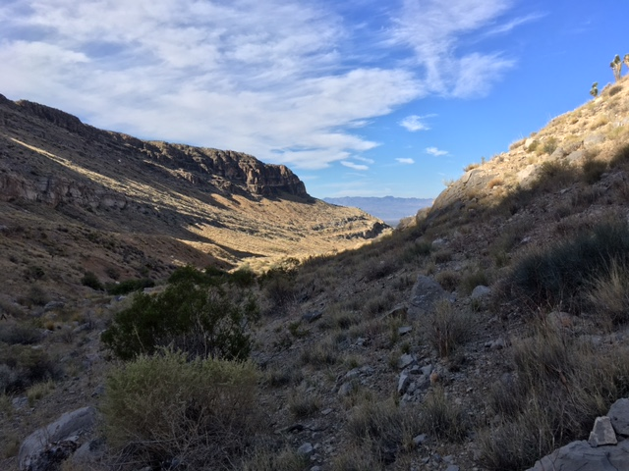
General Terms and Conditions of Sale
The Sandstone Ranch is being offered for sale in its entirety as one Eighty (80) Acre Parcel. The property will be sold as is, where is and with all faults, all cash at Close of Escrow at a Purchase Price of $4,800,000.
This Property is being offered exclusively by Clark County Management, Corporation and shown by appointment only. Any third-party representation is prohibited without prior written approval.

