Slide 1
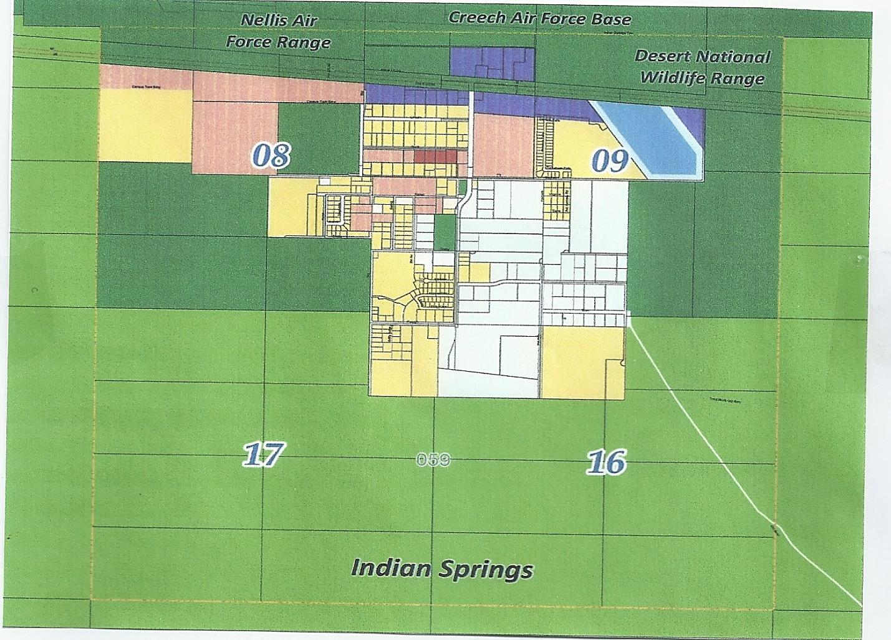
CREECH AIR FORCE BASE
US HWY 95
FAMILY DOLLAR STORE
Opened February. 2020
TERREBLE HERBST CASINO, GAS, BOB’S BIG BOY RESTAURANT
Opened June 2020
PROPOSED INDIAN SPRINGS APARTMENTS
PROPOSED
NATI0NAL GUARD ARMORY AND
TRAINING CENTER
BEAZER HOMES
190 SINGLE FAMILY HOMES
Under Construction
TOUCHSTONE, INDIAN SPRINGS
40 RESIDENTIAL UNITS
Construction Completed late 2019
AVAILABLE
AVAILABLE
SOLD
SOLD
AVAILABLE
SOLD
SOLD
US BLM Land

